Slide 1
iSol Application GCP DevOps/SRE Engineer Assessment
Author : Irfath Ramiz

Slide 2
Application Access
iSol Application | http://34.126.217.38/
Application Code | https://github.com/Irfath/isol-application-code.git
Terraform Deployment Code | https://github.com/Irfath/isol-app.git
Garafana Monitoring | http://34.131.183.212/
ArgoCD | https://34.131.189.205/

Slide 3
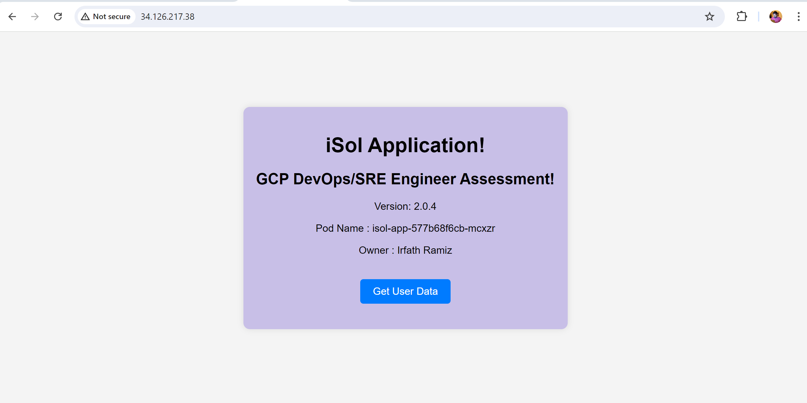
iSol Application The iSol Application is a simple application designed to retrieve data from a MySQL database. It can be implemented to store any kind of data in the MySQL database with certain user privileges.

Slide 4
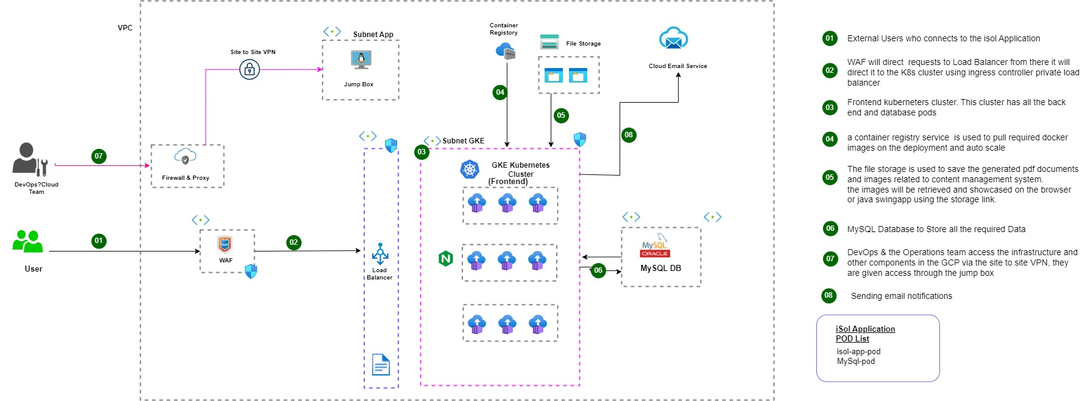
iSol Architecture

Slide 5
Application Version Upgrade
ArgoCD gitOps tool has been used to Deploy Patch updates & application Version Upgrades.
Zero Downtime Application version upgrades.

Slide 6
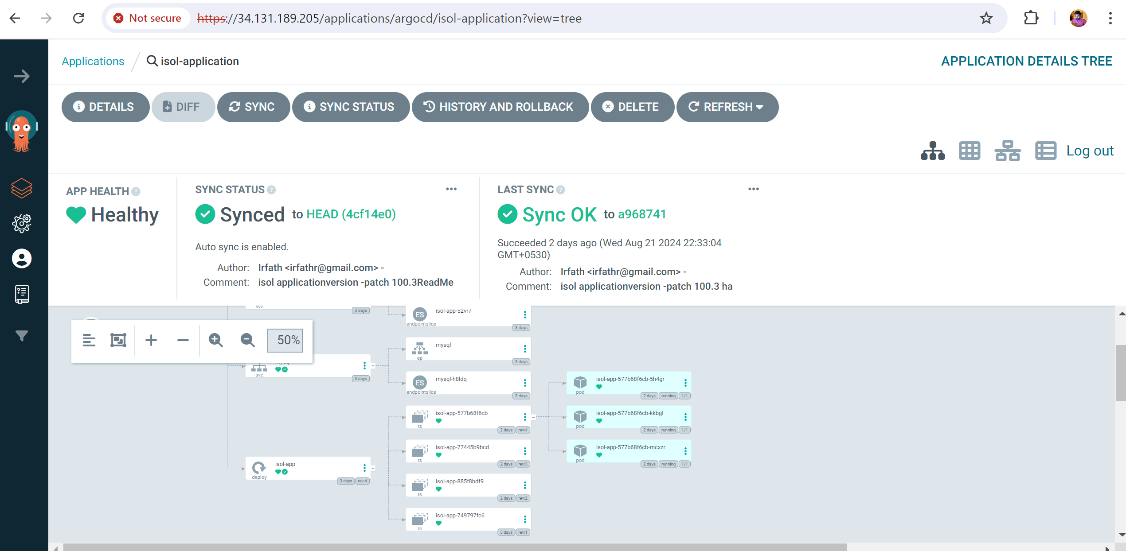
ArgoCD -

Slide 7
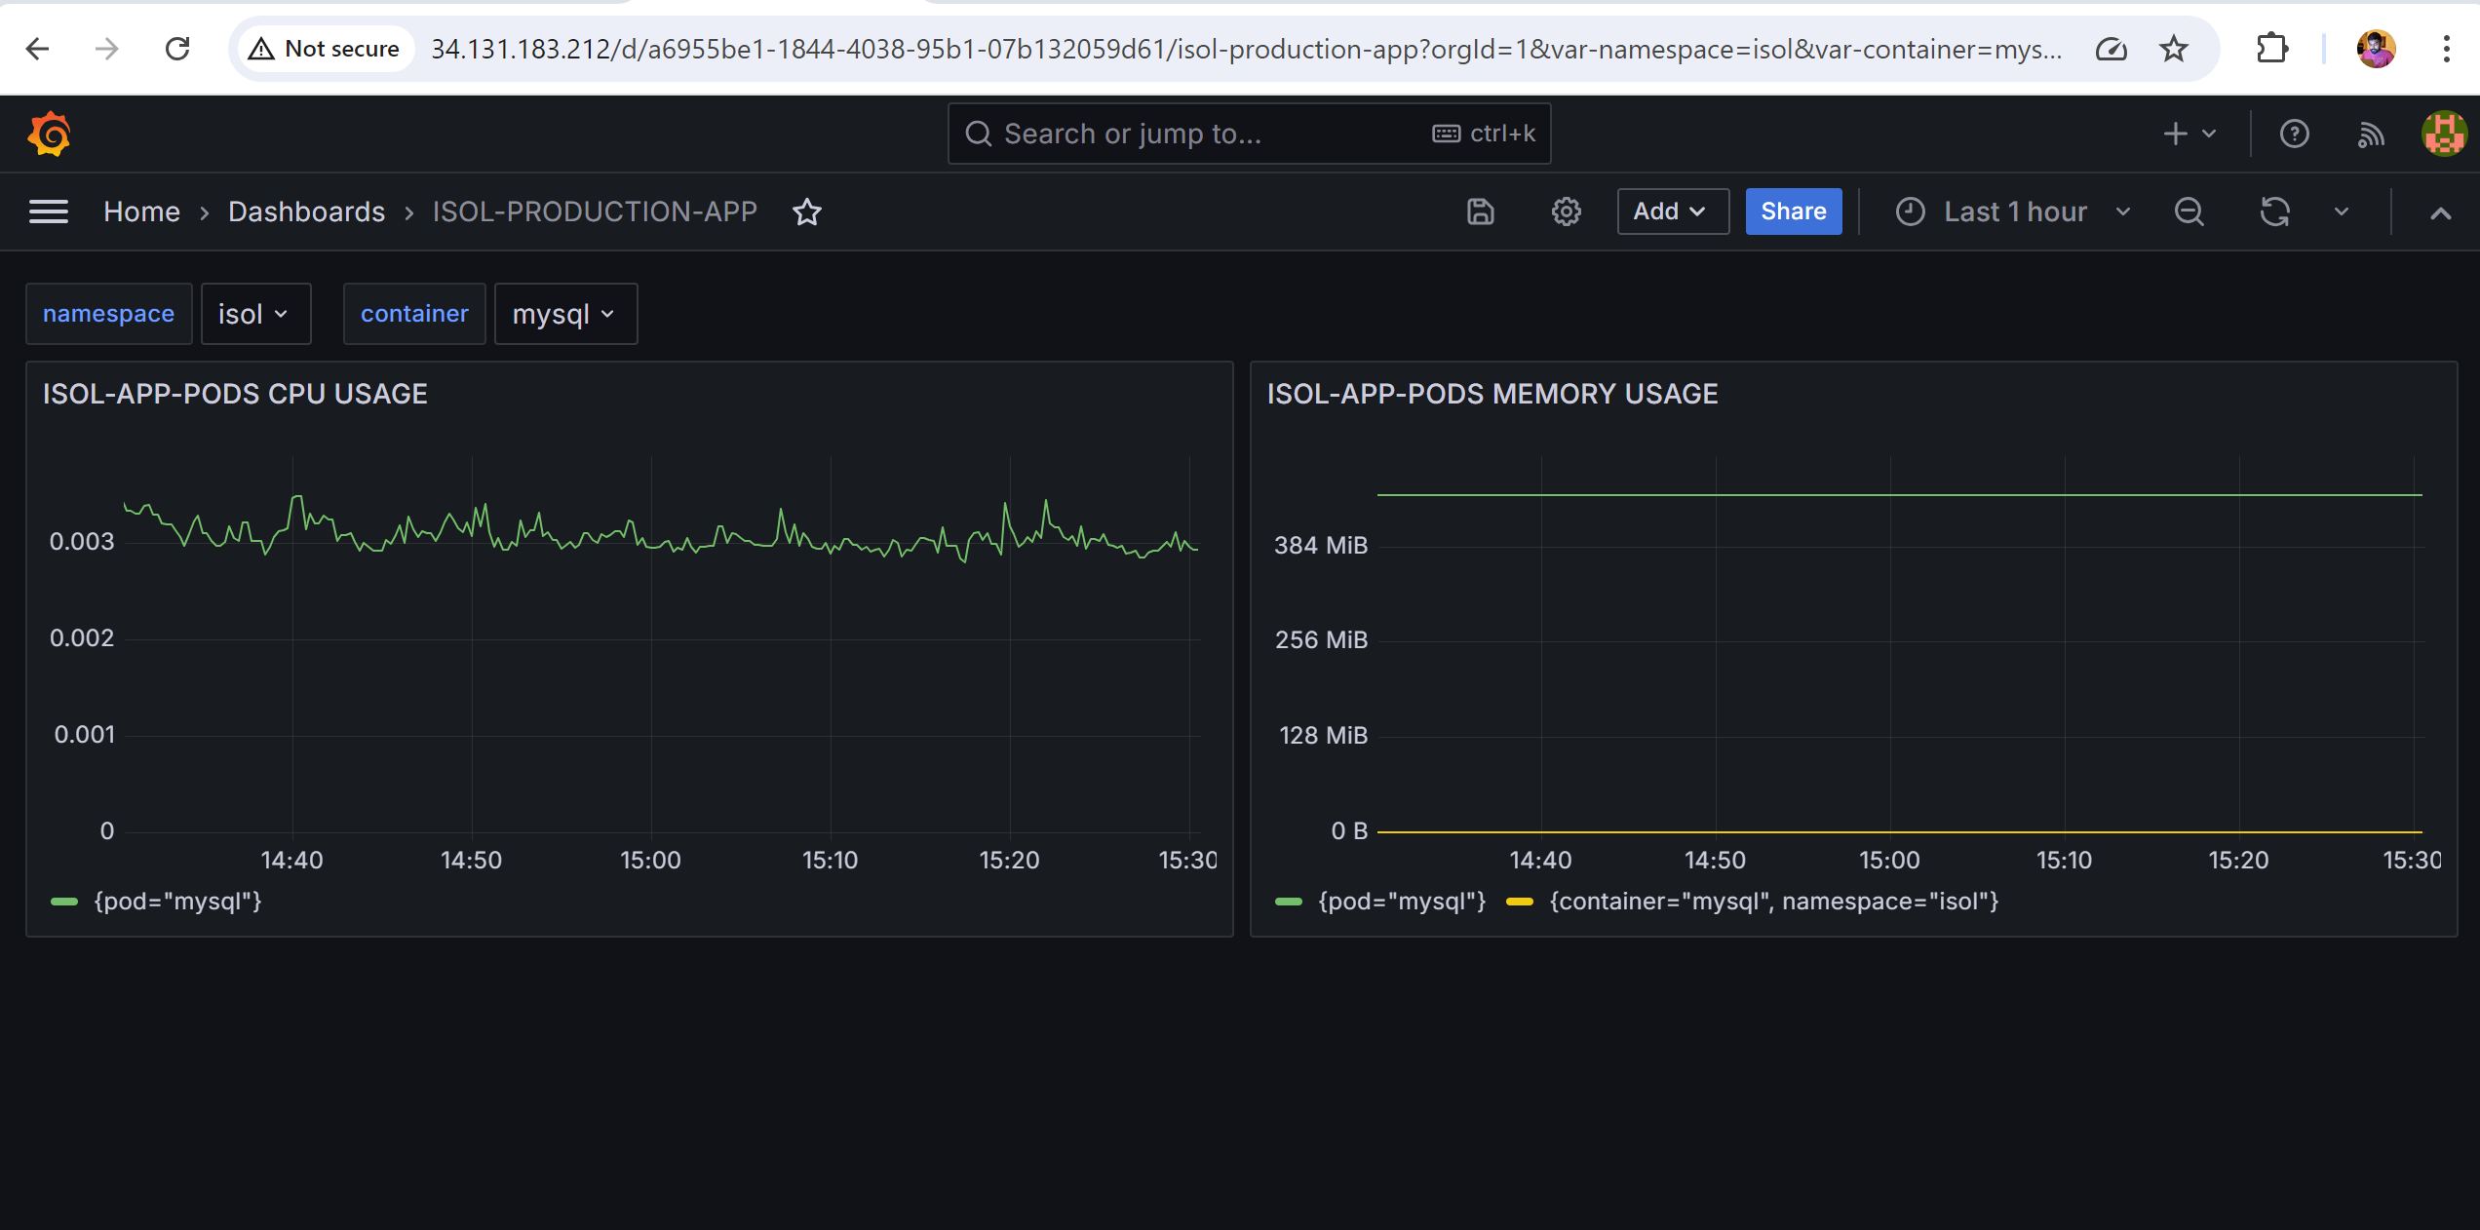
Monitoring - Garfana

